Slide 1
Ambient-Temperature Processing
At the time of harvest or slaughter, most foods are likely to contain contaminants, to have components which are inedible or to have variable physical characteristics (for example shape, size or colour).
It is therefore necessary to perform one or more of the unit operations of cleaning, sorting, grading or peeling to ensure that foods with a uniformly high quality are prepared for subsequent processing.

Slide 2
Cleaning
Cleaning is the unit operation in which contaminating materials are removed from the food and separated to leave the surface of the food in a suitable condition for further processing.
Peeling fruits and vegetables, skinning meat may also be considered as cleaning operations. Cleaning is thus an effective method of reducing food wastage, improving the economics of processing and protecting the consumer.

Slide 3
Cleaning
Equipment for cleaning is categorised into wet procedures and dry procedures .
Wet cleaning: Wet cleaning is more effective than dry methods for removing soil from root crops or dust and pesticide residues from soft fruits or vegetables. It is also dustless and causes less damage to foods than dry methods.

Slide 4
Cleaning
Dry cleaning: Dry cleaning procedures are used for products that are smaller, have greater mechanical strength and possess lower moisture content (for example grains and nuts). Dry procedures generally involve smaller cheaper equipment than wet procedures do and produce a concentrated dry effluent which may be disposed of more cheaply.

Slide 5
Sorting
Sorting is the separation of foods into categories on the basis of a measurable physical property. Like cleaning, sorting should be employed as early as possible to ensure a uniform product for subsequent processing. The four main physical properties used to sort foods are size, shape, weight and colour.

Slide 6
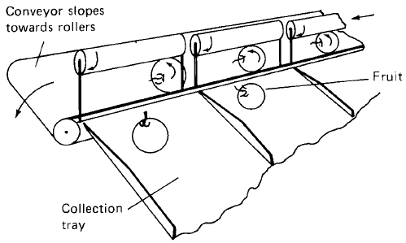
Shape and size sorting
Shape sorting is accomplished either manually or mechanically (for example the belt-and-roller sorter in Fig. below.

Slide 7
Colour sorting: Manual sorting by colour is still widely used but is increasingly expensive in labour costs, operator training and the space required for sorting tables.
Weight sorting: Weight sorting is more accurate than other methods and is therefore used for more valuable foods (for example eggs, cut meats and some tropical fruits).

Slide 8
Grading
This term is used to assessment of overall quality of a food using a number of attributes. Meats, for example, are examined by inspectors for disease, fat distribution, bone to flesh ratio and carcass size and shape.

Slide 9
Peeling
Peeling is used in the processing of many fruits and vegetables to remove unwanted or inedible material, and to improve the appearance of the final product. The main consideration is to minimize costs by removing as little of the underlying food as possible and reducing energy and labour.
Flash steam peeling: Foods (for example root crops) are fed in batches into a pressure vessel which is rotated at 4–6 rpm. High-pressure steam (1500 _ 103 Pa) is introduced and all food surfaces are exposed to the steam by the rotation of the vessel for a predetermined time, which differs according to the type of food.

Slide 10
Knife peeling: Stationary blades are pressed against the surface of rotating fruits or vegetables to remove the skin.
Abrasion peeling: The abrasive surface removes the skin and it is washed away by a copious supply of water.
Caustic peeling: A dilute solution of sodium hydroxide (named lye) is heated to 100–120ºC. Food is passed through a bath of 1–2% lye which softens the skin and the skin is then removed by high-pressure water sprays.

Slide 11
Flame peeling: Developed for onions, this peeler consists of a conveyor belt which carries and rotates the food through a furnace heated to 1000ºC. The outer ‘paper shell’ and root hairs are burned off, and the charred skin is removed by high-pressure water sprays.

